Slide 1
Using graphics hardware
DEV4 day1

Slide 2
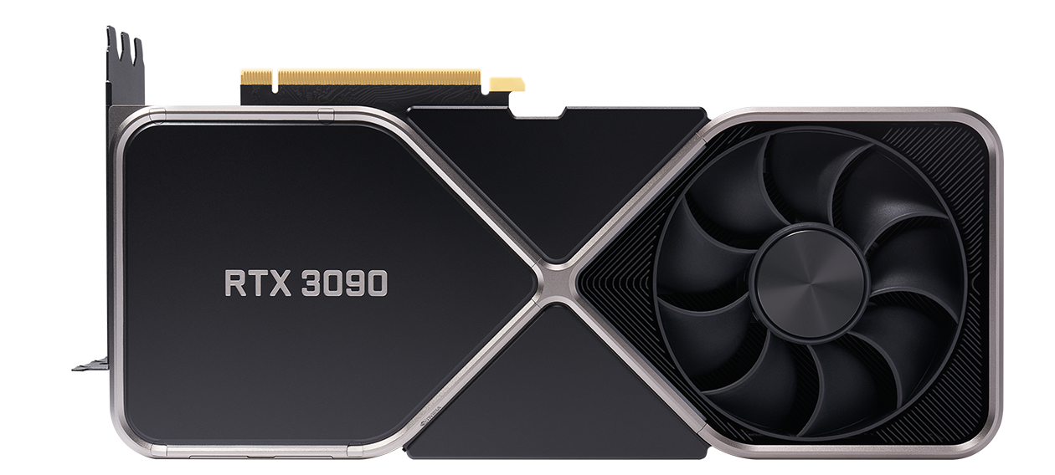
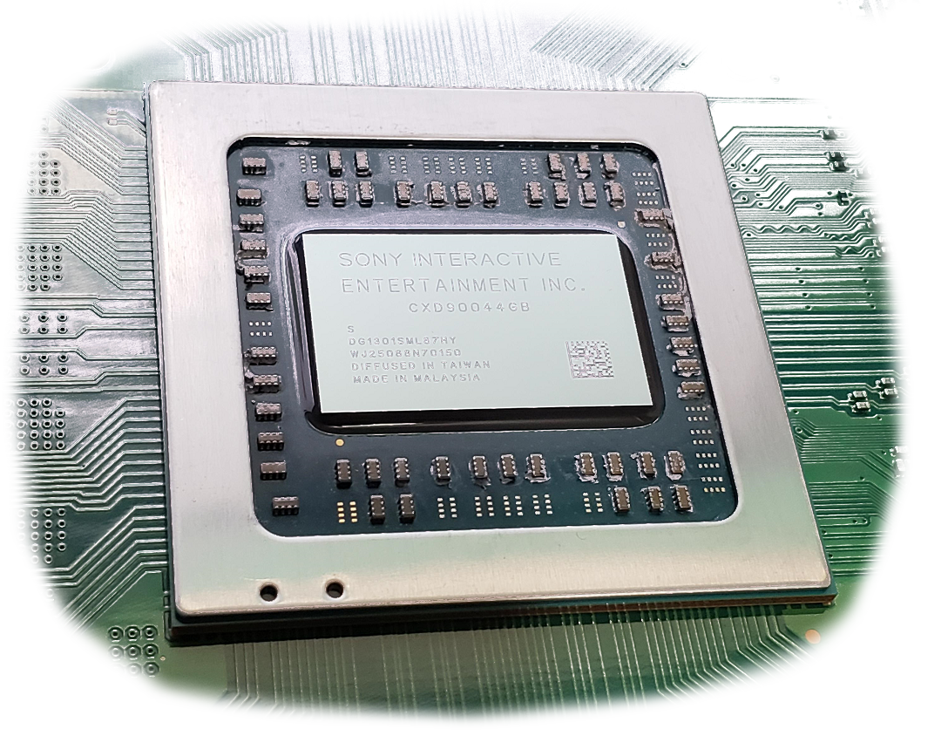
The graphics processing unit (GPU)
PCI EXPRESS SLOT
NVIDIA DISCRETE PC GRAPHICS CARD
AMD RDNA PS5 APU

Slide 3
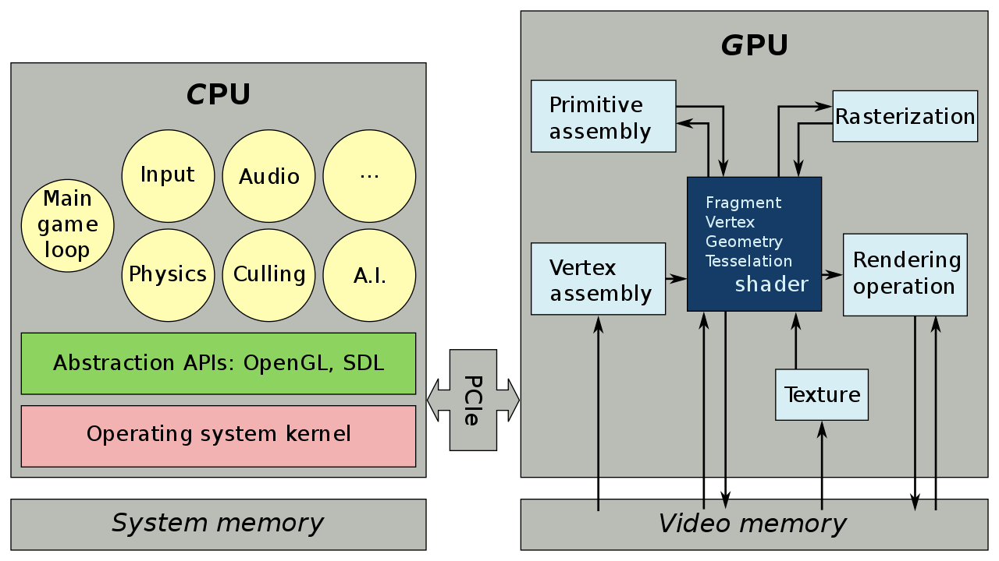
Visualizing games
To make a game whether 2D or 3D we need some visual elements, its typically the first thing that needs to be addressed. 99% of modern games utilize the GPU to draw primarily textured triangles to show this content.
A Renderer is a piece of software that communicates with one or more GPU Abstraction API. These APIs allow skilled programmers to submit large amounts of geometry and texture data for simultaneous processing.
Video Driver
Copy Once: Vertex, Index, Shader, Texture Data

Slide 4
GPU Abstraction API OPTIONS
Vulkan (Windows, Linux, Mac, iOS, Android, Switch)
+ Extremely fast, extremely portable, now supports raytracing.
- GPU/CPU synchronization is the programmer's responsibility.
- Very verbose, lots of code to do even basic operations.
Direct3D12 (Windows & Xbox)
+ Arguably as fast as Vulkan, feature rich, was the first API to support raytracing(DXR).
- Not opensource, limited platforms, also requires manual CPU/GPU synchronization.
- Also quite verbose, though less so than Vulkan.

Slide 5
API OPTIONS CONTINUED
Direct3D11 (Windows & Xbox)
+ An industry standard for years! Handles CPU/GPU synchronization for you.
- Same issues as it’s big brother: closed-source, limited selection of platforms.
- Less efficient and flexible vs. D3D12 or Vulkan, no raytracing.
OpenGL (Easier to list where it isn’t available: Xbox and Apple)
+ The OG opensource graphics API, arguably the easiest API to learn and use.
- Historically terrible and outdated driver support, burdened with legacy features.
- Performance & features are adequate, though lacking compared to newer APIs.

Slide 6
GRAPHICS API Commonalities
Since all these APIs access the same piece of hardware, they often have similar use patterns.
In general, all of them have a means of letting you allocate and copy geometry, shader and texture resources to the video card’s memory.
Most APIs do this by having you pass a double pointer to a Create() function. This allows the API itself to allocate the memory and then dereference the pointer you passed it to be valid.
They also have functions that allow you to set/bind what specific resources you are using during a draw call. (ex: vertex buffer, index buffer, shaders, textures)
Another common pattern is the use of descriptors. These are structures that contain a function’s arguments inside so that all the arguments can be passed by pointer or reference.
All Graphics APIs can use the shader language HLSL aside from OpenGL & Apple’s Metal.

Slide 7
API Pipelines (the graphics pipeline)
VERTEX & INDEX ARRAYS
PRIMITIVE ASSEMBLY
VERTEX SHADER
CLIPPING & RASTERIZATION
OUTPUT TEXTURE
TEXTURE DATA
UNIFORMS
INTERPOLATED PIXELS
DEPTH
STENCIL
SCISSOR
ALPHA
PIXEL SHADER

Slide 8
RASTERIZATION HAPPENS IN NDC
+1Y
+1Z
The vertex shader must output an xyzw vertex position in homogenous projection space. (Or just set W to 1 to use NDC)
The rasterizer unit on the card performs XYZ/W for you because it is responsible for clipping any primitives which must happen first.
The card then rasterizes the point/line/triangle and interpolates all the attributes returned from the vertex shader.
All pixels falling within the viewport are then passed to the pixel shader.
-1X
+1X
-1Z
-1Y

Slide 9
NDC API DIFFERENCES
Vulkan
Left side -1x, Right side +1x, Top -1y, Bottom +1y, Near +0z, Far +1z
Direct3D11 & 12
Left side -1x, Right side +1x, Top +1y, Bottom -1y, Near +0z, Far +1z
OpenGL
Left side -1x, Right side +1x, Top +1y, Bottom -1y, Near +1z, Far -1z

Slide 10
Geometry submission: VULKAN
Objects
VkBuffer, VkDeviceMemory
Creation Functions
GvkHelper::create_buffer(…), GvkHelper::write_to_buffer(…)
Pipeline Descriptors
VkPipelineInputAssemblyStateCreateInfo, VkVertexInputBindingDescription, VkPipelineVertexInputStateCreateInfo
Binding Functions
vkCmdBindVertexBuffers(…), vkCmdBindIndexBuffer(…)
Clean-up Functions
vkDestroyBuffer(…), vkFreememory(…)

Slide 11
Geometry submission: DIRECT3D11
Objects
ID3D11Buffer*, ID3D11InputLayout*
Creation Functions
CreateBuffer(…), CreateInputLayout(…)
Setting Functions
IASetVertexBuffers(…), IASetInputLayout(…), IASetIndexBuffer(…)
Clean-up Functions
Release(…)

Slide 12
The rule of three
C/C++ VERTEX STRUCTURE
API VERTEX MEMORY LAYOUT
VERTEX SHADER INPUT ARGUMENTS

Slide 13
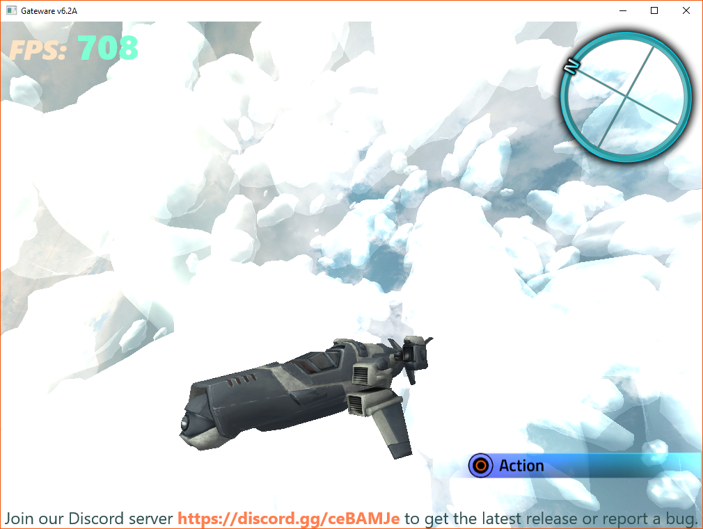
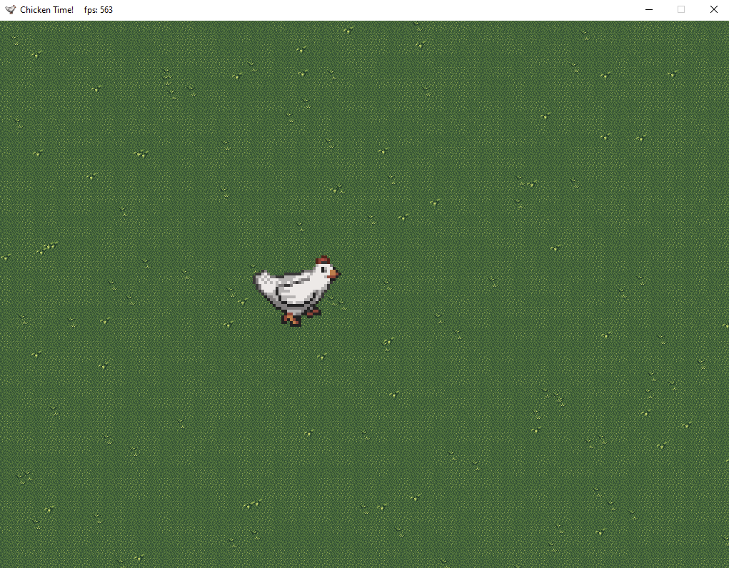
gateware

Slide 14
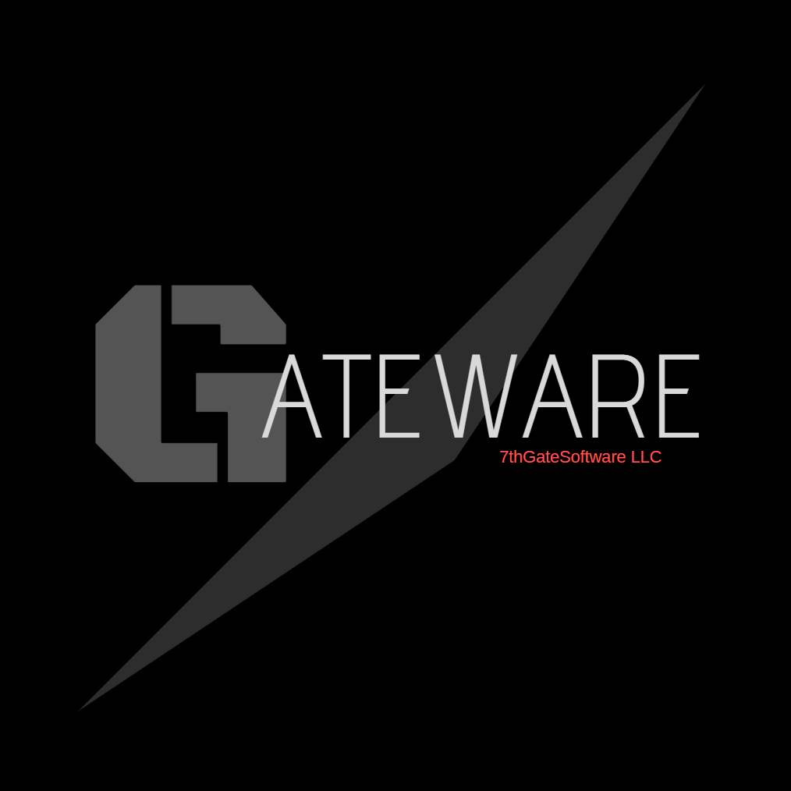






C++11 single header platform abstraction library
Ongoing development since 2016
Provides simple and modular access to OS level services such as graphics, sound, input and much more!
The name is a mash-up of my company name and the term middleware
Without it we would lose days/weeks to API initialization boilerplate
100% Opensource (MIT Licensed)
Similar Projects: SDL, SFML
Where you will find some previous authors and contributors:

Slide 15
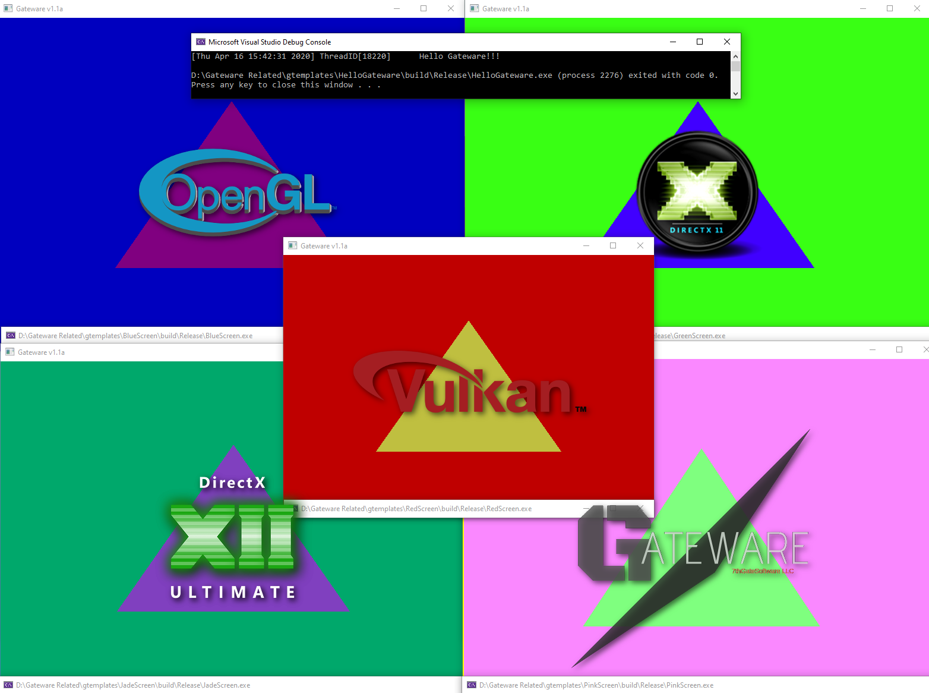

Slide 16
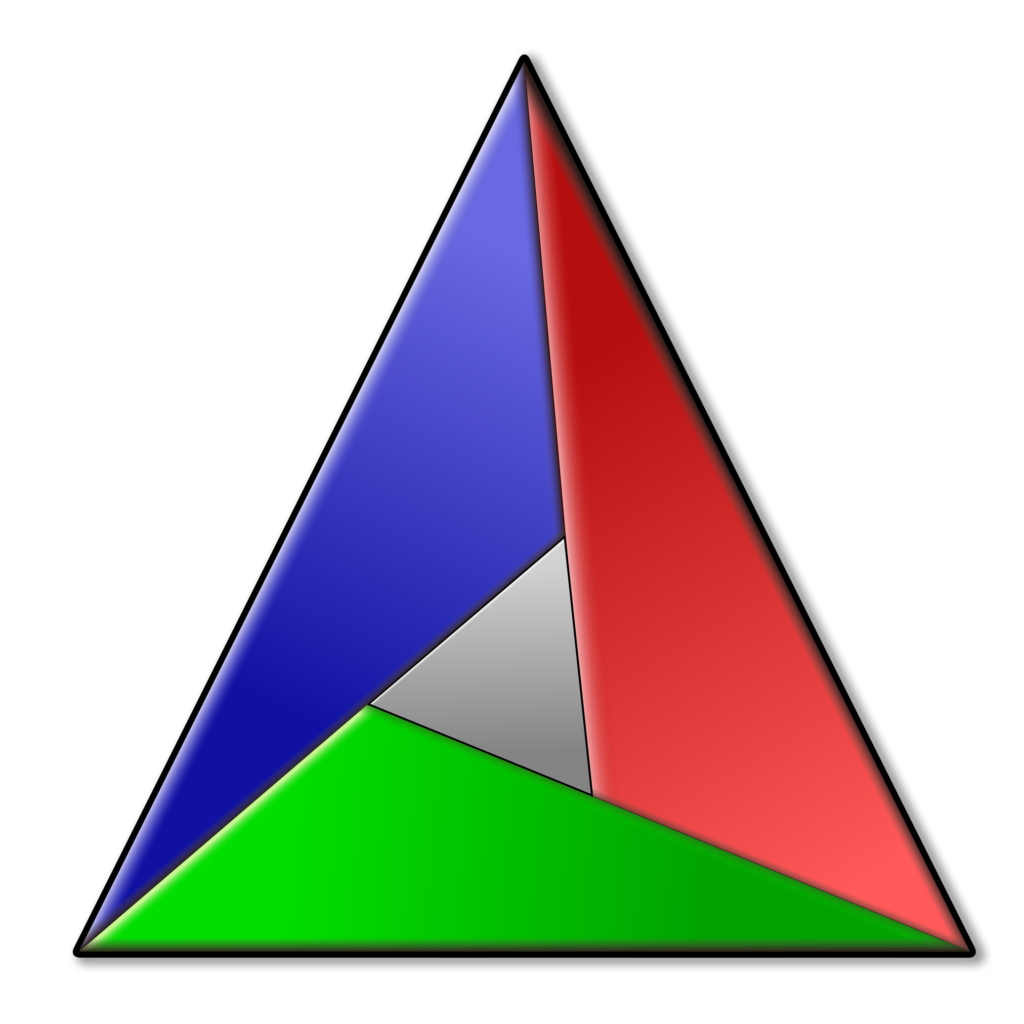
CMAKE
A popular and free C/C++ software development tool that uses a script to create a platform specific IDE solution for your code.
The principal idea being that instead of maintaining a project/solution for every platform you just maintain one CMake script file.
Gateware and CMake are two different things, one does not require the other.
However, Gateware does use CMake for each of its templates as it makes sense to do so for libraries like Vulkan and OpenGL.
Important: Solutions generated by CMake are non-portable. You must re-run CMake anytime your code moves to a new location.

Slide 17
Q

